Slide 1

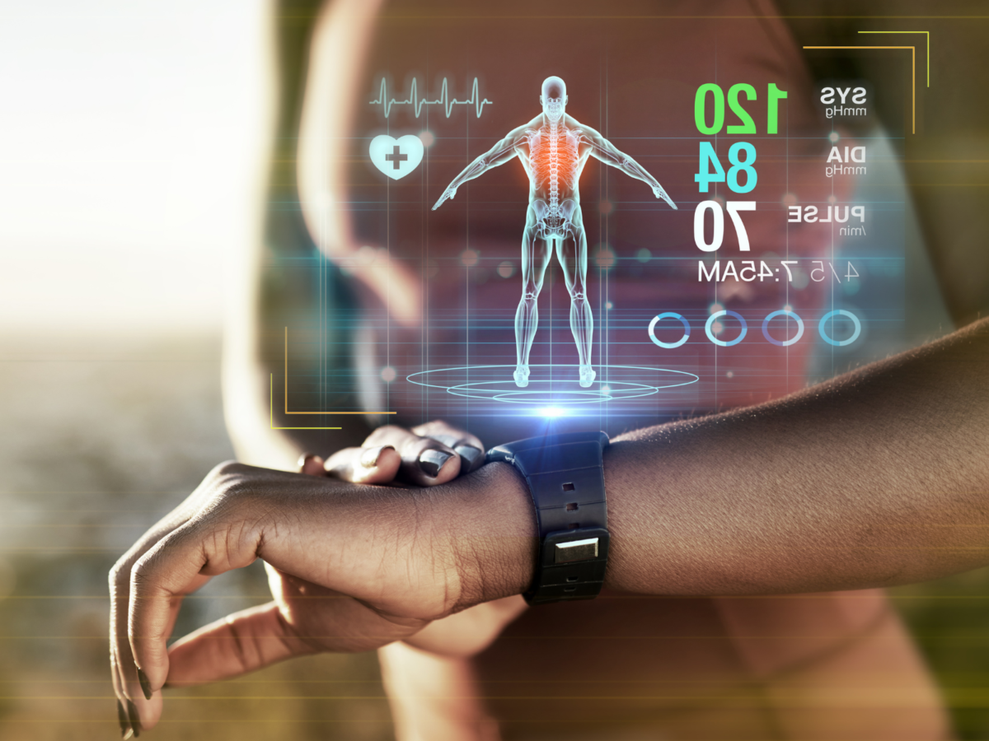


WEARABLES HEALTH
DATA ENGINEERING PROJECT
BY\MAHMOUD SAAD
\ali abdallah

Slide 2
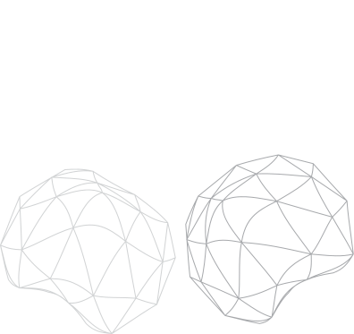
INTRODUCTION
This dataset represents six months of daily health tracking data for 300 individuals
generated using a physiologically realistic synthetic model.
It simulates data collected from modern wearable devices such as smartwatches and fitness bands.

Slide 3

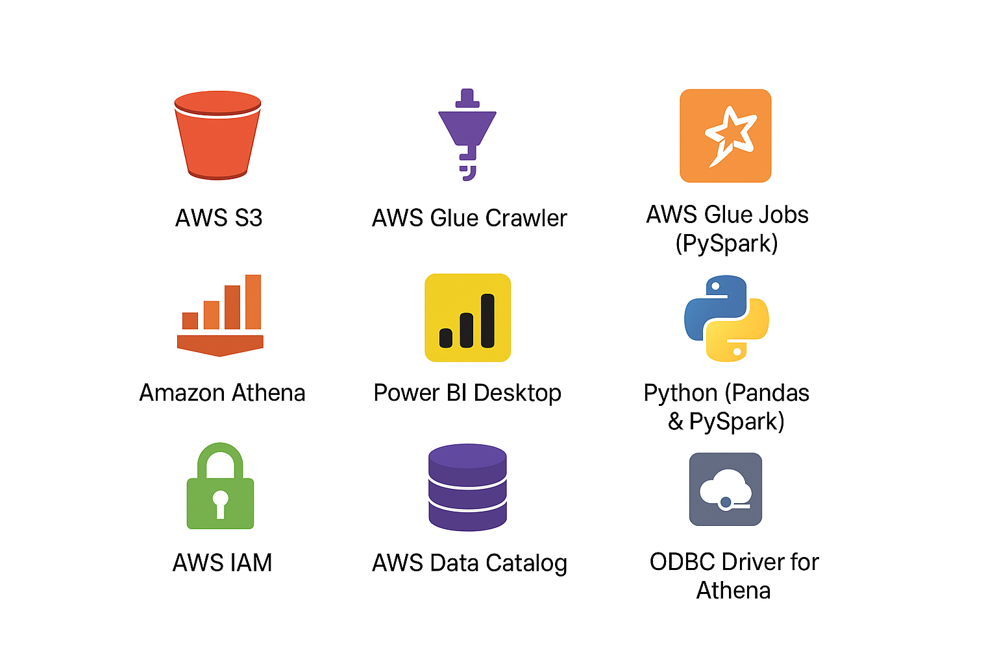
tools

Slide 4
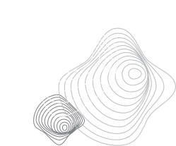
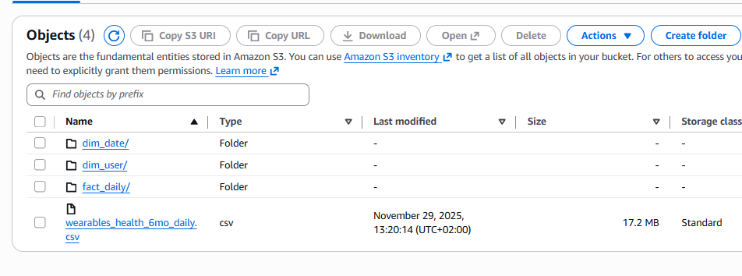
DATA LOADING & PREPARATION

Slide 5

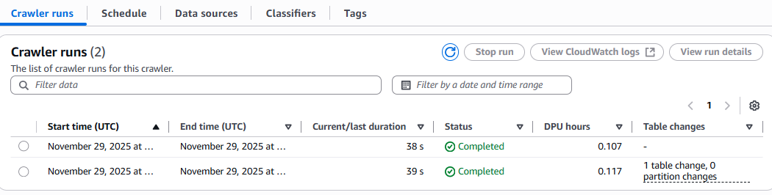
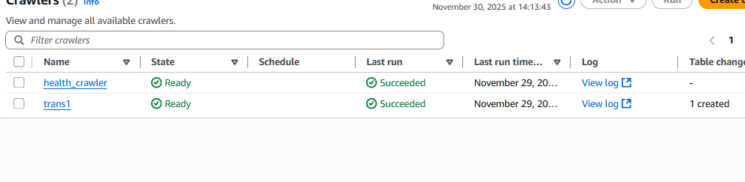
GLUE CRAWLER
Identifies column names
Detects column data types
Understands the table structure
Saves everything into the AWS Data Catalog
💡

Slide 6

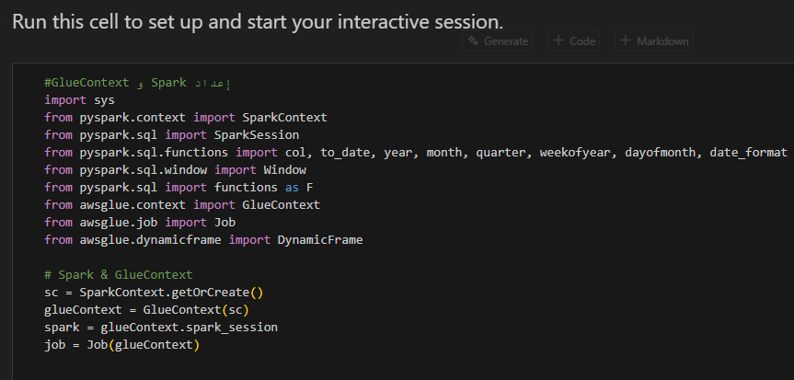
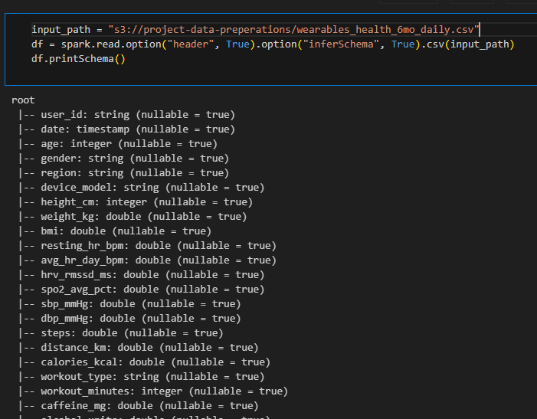
TRANSFORMATIONS USING PYSPARK

Slide 7
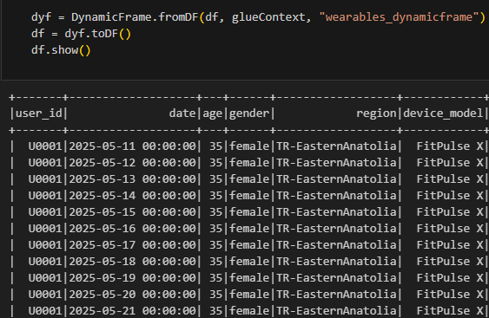
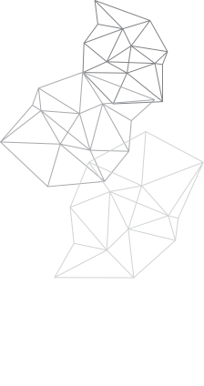
TRANSFORMATIONS

Slide 8
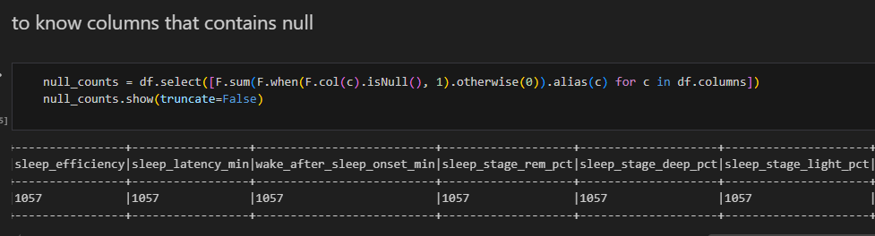
TRANSFORMATIONS
DETECT FOR NULL COLUMNS AND COUNT HIM

Slide 9
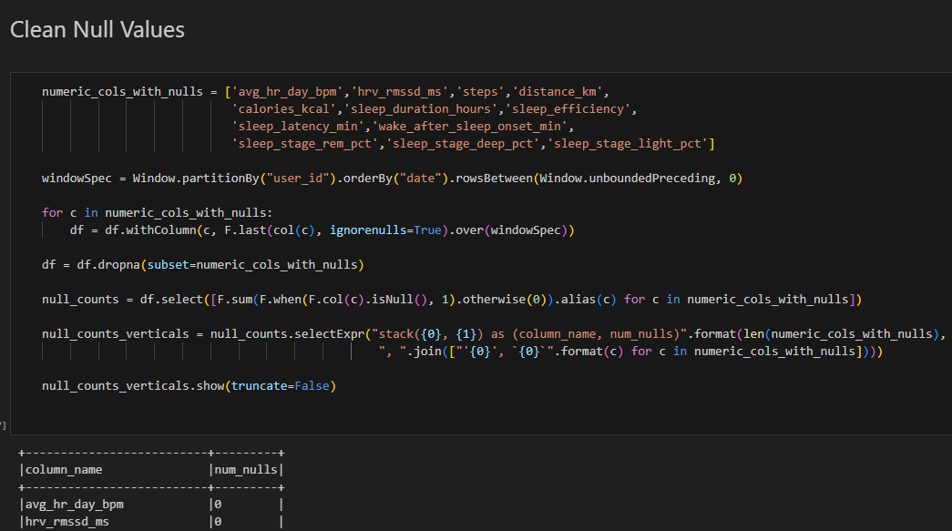
TRANSFORMATIONS

Slide 10
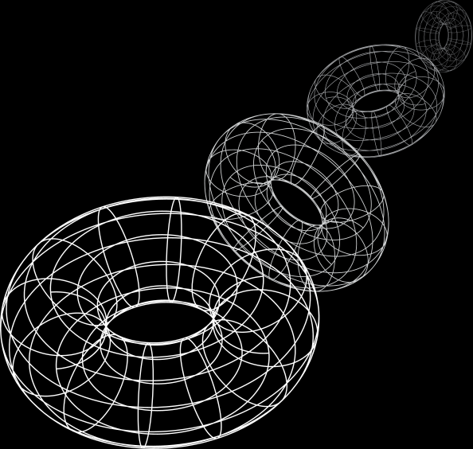
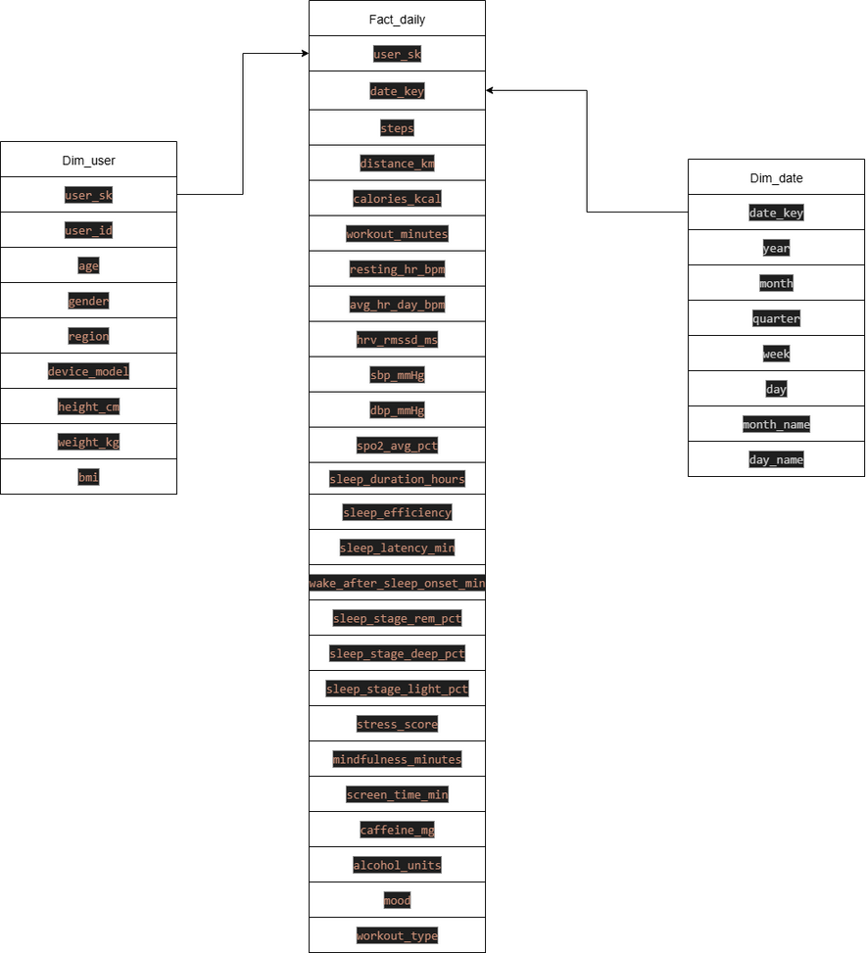
STAR SCHEMA DESIGN IN DATA WAREHOUSE

Slide 11
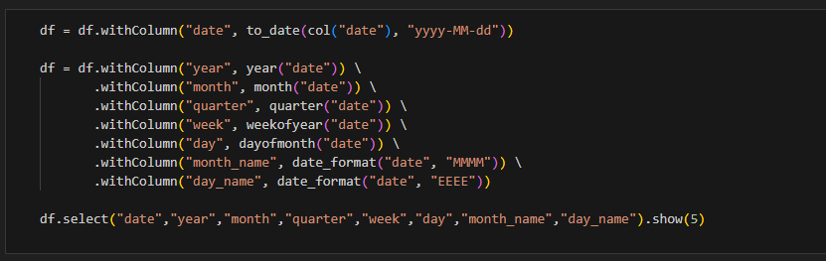
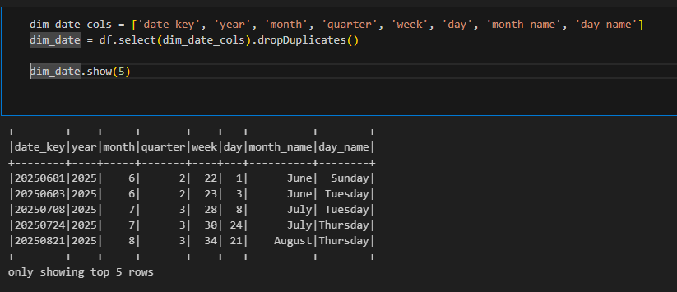
DIM DATE

Slide 12
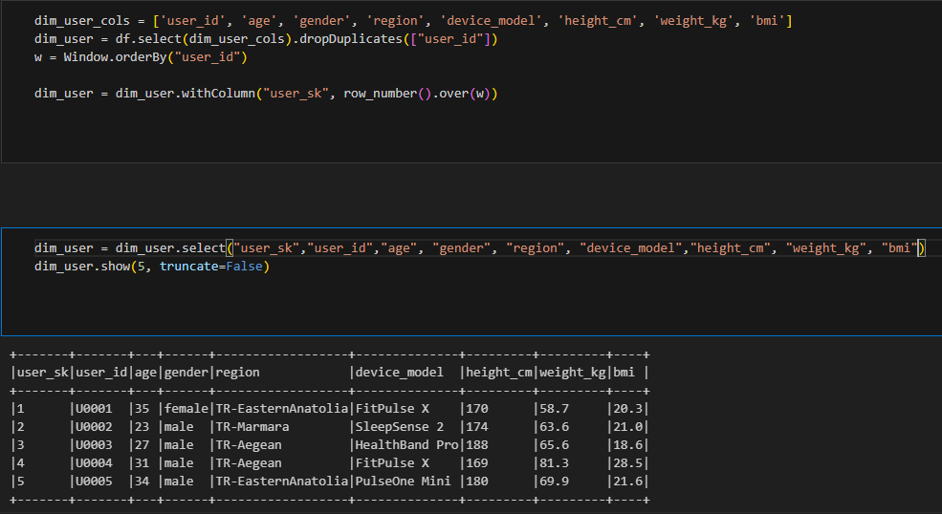

DIM USER

Slide 13
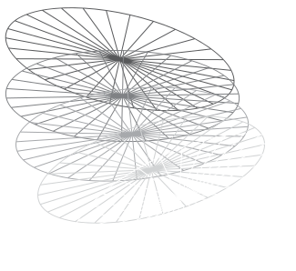
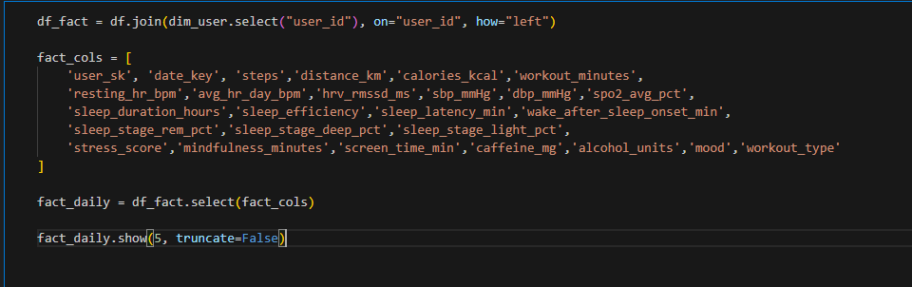
FACT DAILY

Slide 14

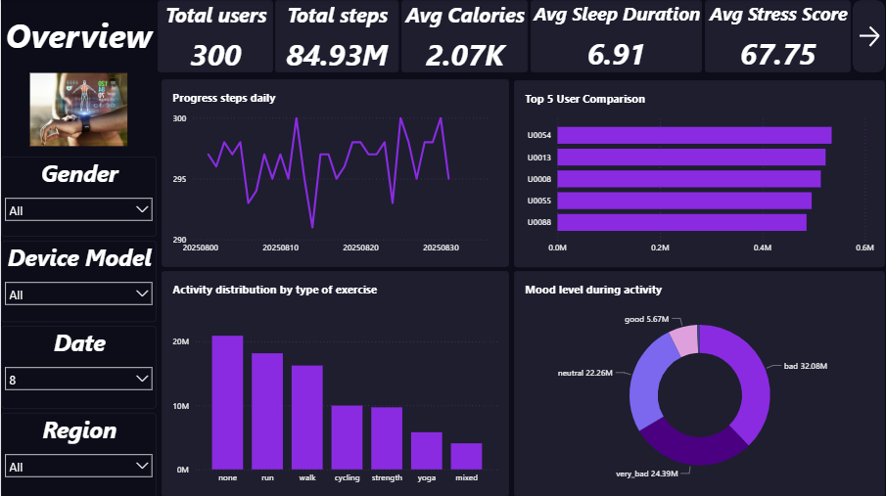
POWER BI DASHBOARD

Slide 15
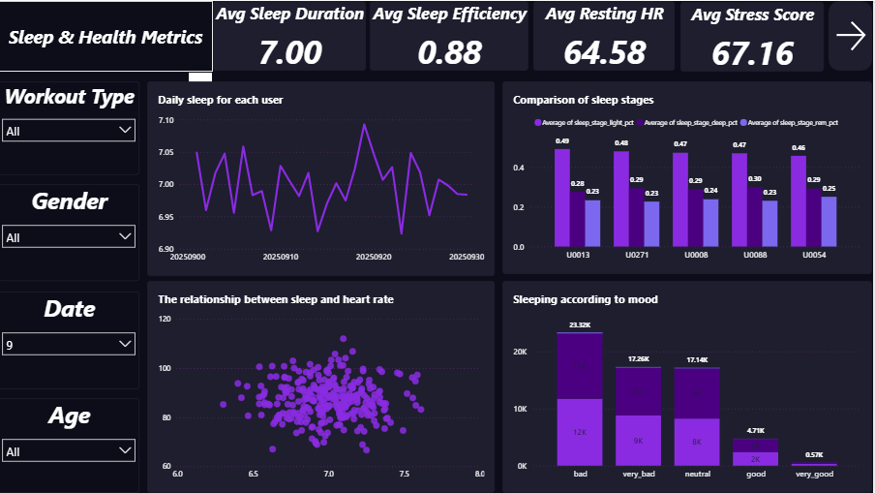
POWER BI DASHBOARD

Slide 16
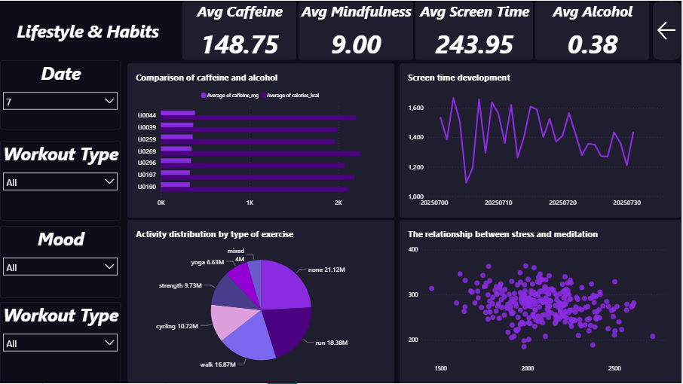
POWER BI DASHBOARD

Slide 17
THANK YOU

